Slide 1
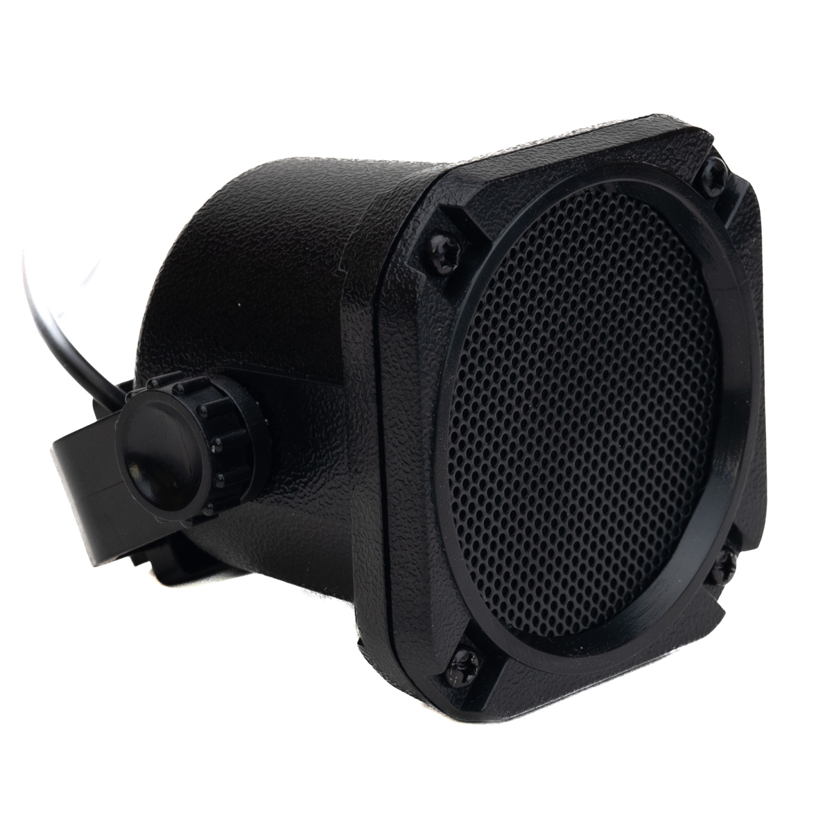
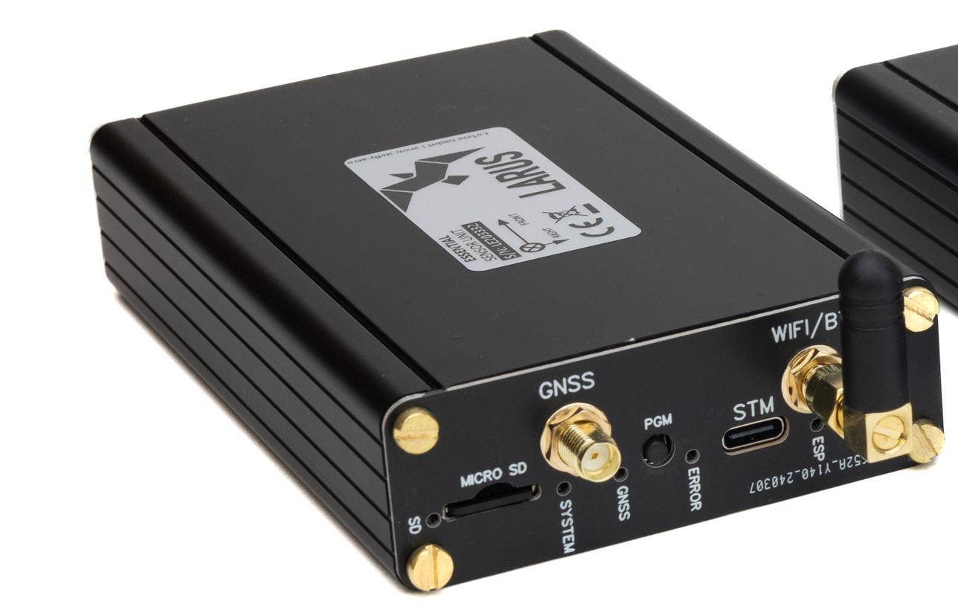
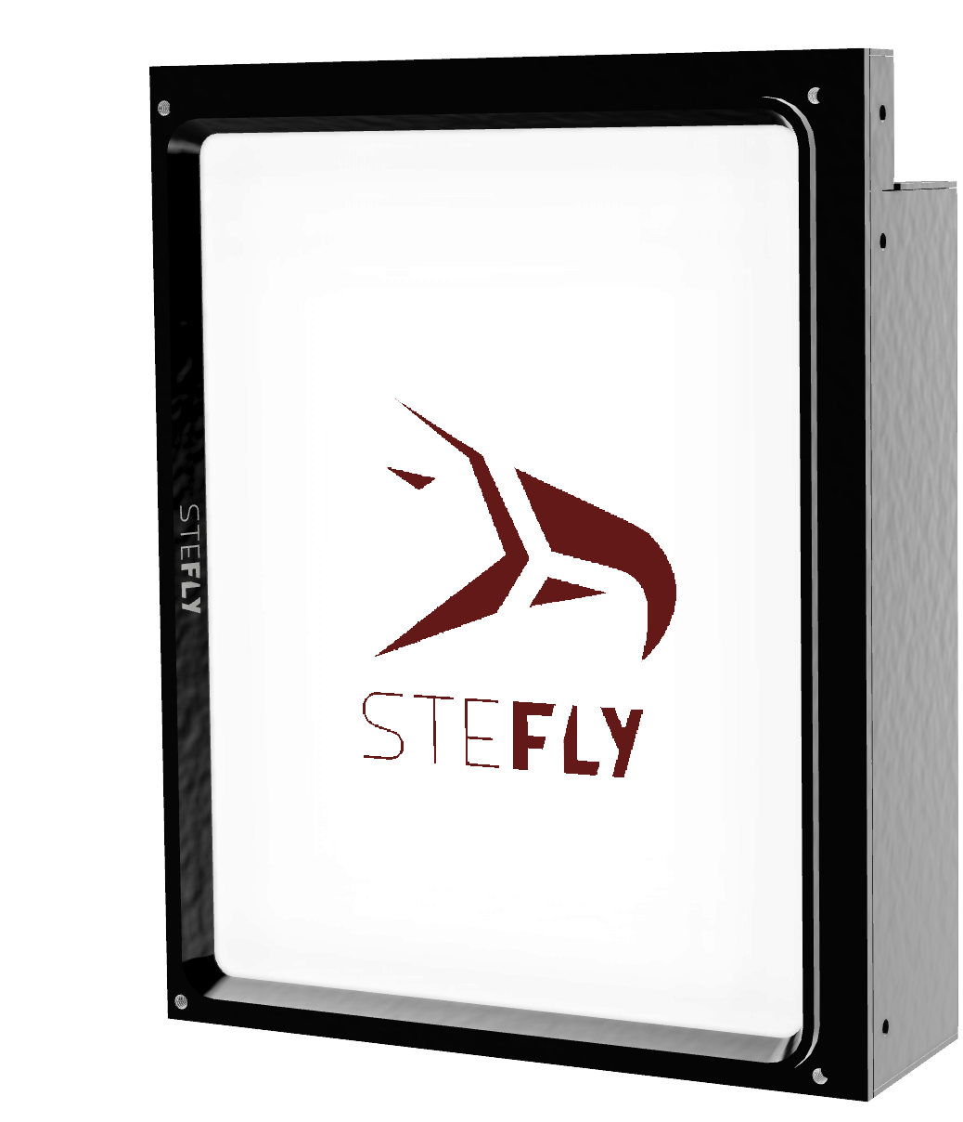
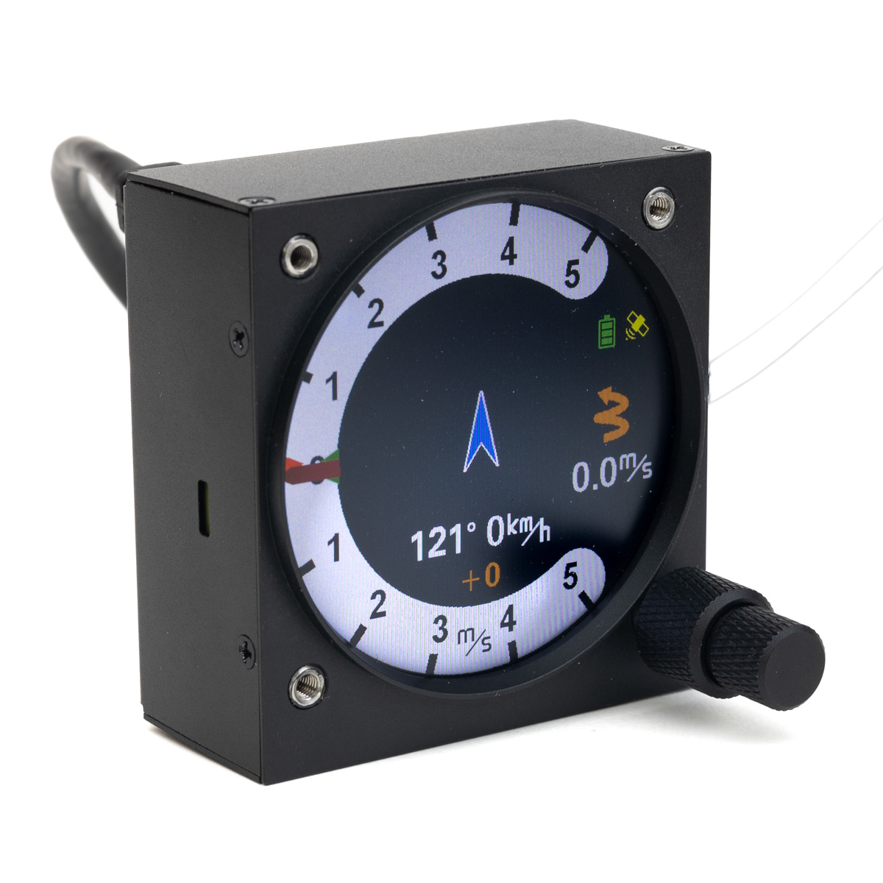
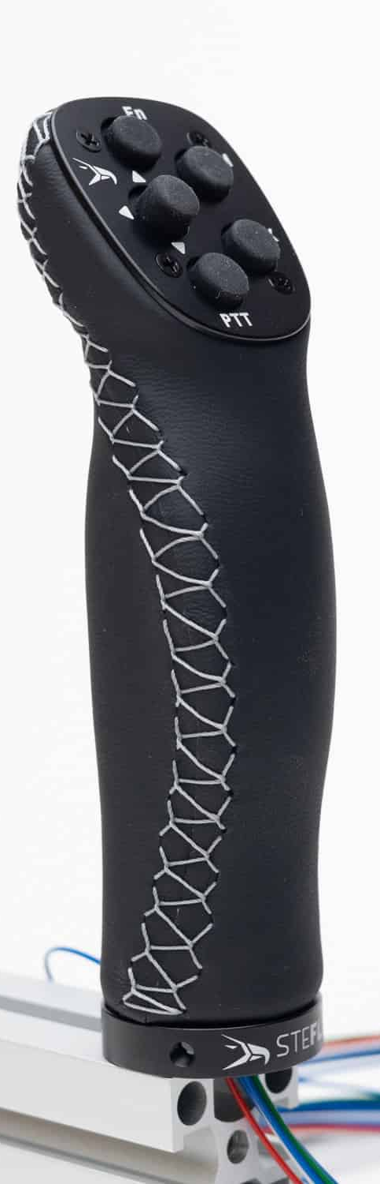
3,5 mm audio jack
1:1 patch cable
CAN port
CAN port
RS232 port
Rx / Tx crossed patch cable
ttySz
STF / Vario
Switch connected to Remote Control PCB
USB cable

